Slide 1

Analyzing Spam Perception and Response using Data Mining Techniques

Slide 2


TABLE OF CONTENTS
Introduction
Research Question and Scope
Motivation
Literature Review
Methodology
Results
Conclusion
Limitation
Future Work

Slide 3
Data mining is currently a crucial method for gleaning knowledge and insights from huge databases. The capacity to analyze and comprehend data has grown in significance in the modern world when data is produced at an unparalleled rate.
Our inquiry intends to investigate the trends and connections among several elements in a dataset of consumer feedback, including age, gender, and response to spam. We will give a brief overview of our data mining effort in this talk, which involves applying multiple data mining methods to the dataset, including fundamental statistics, data visualization, and machine learning algorithms. We will be better able to comprehend the variables that affect client feedback and pinpoint areas for development in our business operations thanks to the insights gathered from this investigation.
INTRODUCTION

Slide 4
The goal of this study is to examine and comprehend the trends and elements that affect people's responses to spam communications.
The scope of this analysis is limited to a particular dataset that includes information on individuals' demographics, their perception of spam, their response to spam, and other related factors.
Through this analysis, we aim to identify the key factors that influence individuals' response to spam and develop predictive models to forecast their behavior.
The findings of this research can have important implications for marketers and policymakers in developing more effective strategies to combat spam and protect consumers' privacy.
RESEARCH QUESTION AND SCOPE

Slide 5
Any research project, including this one, needs to have strong motivation. The need to create efficient methods for detecting and filtering spam and its increasing prevalence are the driving forces behind this project.
In addition to being annoying, spam emails can pose a serious threat to both individuals and organizations because they may contain harmful links or attachments that can compromise computer systems and steal private information.
Therefore hope to contribute to the development of better spam detection techniques that can improve email security and shield users from potential harm by analyzing the dataset and creating models that can accurately classify spam emails. Additionally, the dataset analysis can reveal details about people's characteristics.
MOTIVATION

Slide 6
LITERATURE REVIEW
"Detecting Spam in Transportation Networks using Machine Learning" by A. Maier, J. Waldinger, C. A. Boergers, and S. Hoermann. IEEE Intelligent Transportation Systems Conference (ITSC), 2018. Published by IEEE.
"An Analysis of SMS Spam in Public Transport" by M. M. Islam, G. Prasetyo, M. Matsui, and Y. Oie. IEEE Consumer Communications and Networking Conference (CCNC), 2017. Published by IEEE.

Slide 7
Data mining techniques were employed in this study's methodology to glean insightful information from the provided dataset. The dataset was initially put into a pandas DataFrame, where a preliminary statistical analysis was carried out to better understand the data. To further investigate the correlations between variables in the dataset, visualizations including histograms, bar charts, scatter plots, box plots, and stacked bar charts were made.
Decision tree, KNN, random forest, and logistic regression algorithms were applied to the dataset to predict the response to spam based on age, gender, and perception of spam. K-means clustering was utilized to identify unique groups within the data. These algorithms' effectiveness was assessed using measures like recall, accuracy, precision, and support.
Methodology used in this study was effective in uncovering patterns and relationships in the dataset and providing valuable insights into the behavior and perception of spam among the respondents.
METHODOLOGY

Slide 8
Discussion and Implementation
We can explore the main conclusions of our investigation and their repercussions. For instance, we discovered a positive association between age and spam perception, suggesting that older people are more discerning when it comes to spotting spam messages. In a similar vein, we found that while women are more likely than men to report spam, they are also more inclined to reply to it. Marketers can utilize these findings to modify their communication approaches and lessen the negative effects of spam on users.
We can talk about the several machine learning techniques that were used on the dataset, including decision trees, KNN, and random forests, to create forecasting models for spam responses. Email clients can utilize these models to automatically filter out spam messages and enhance user experience Furthermore, the clustering analysis conducted on a subset of the data can be used to identify distinct user groups with varying levels of vulnerability to spam, allowing for targeted messaging and intervention strategies.
METHODOLOGY

Slide 9
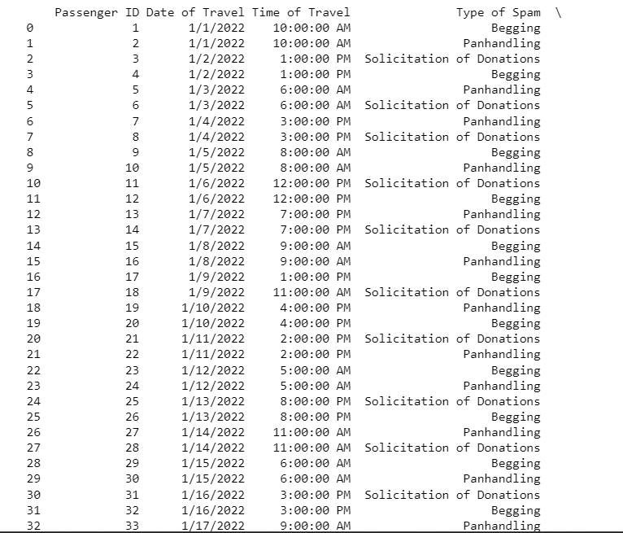
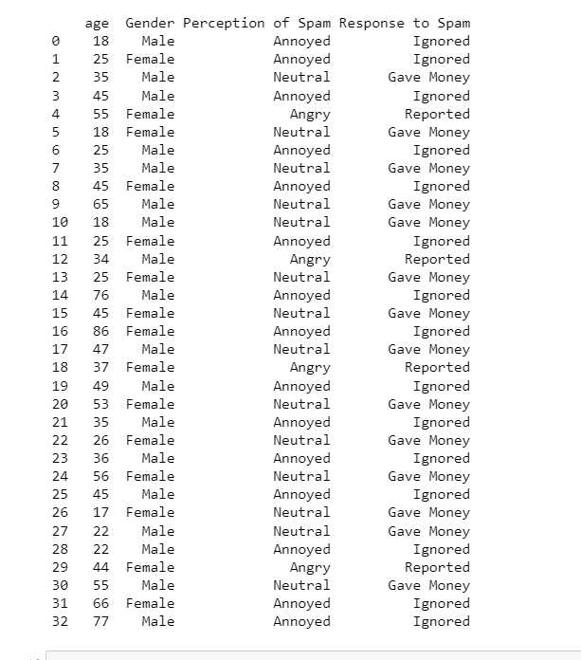
Results

Slide 10
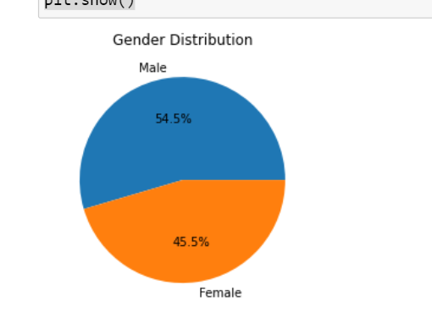
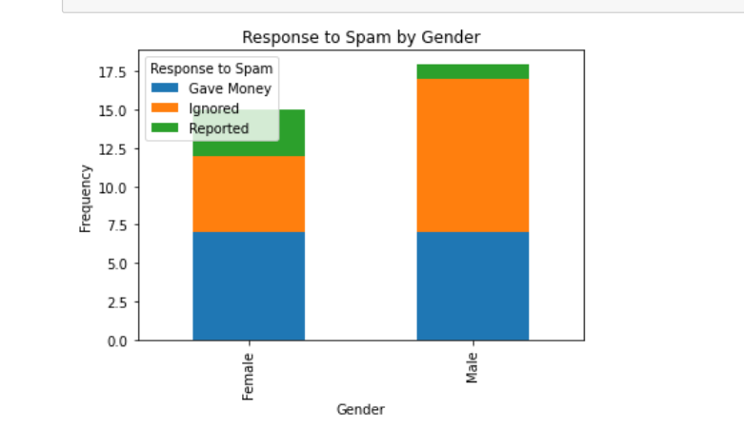
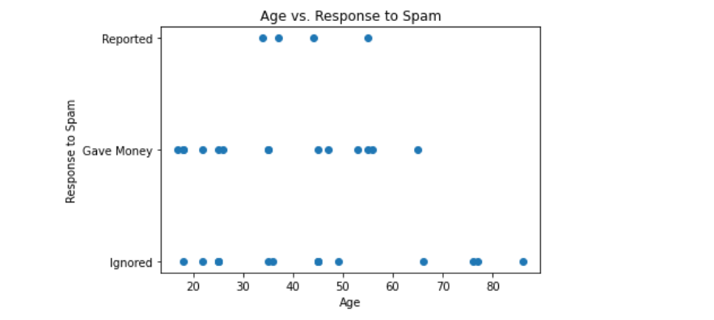
Results

Slide 11
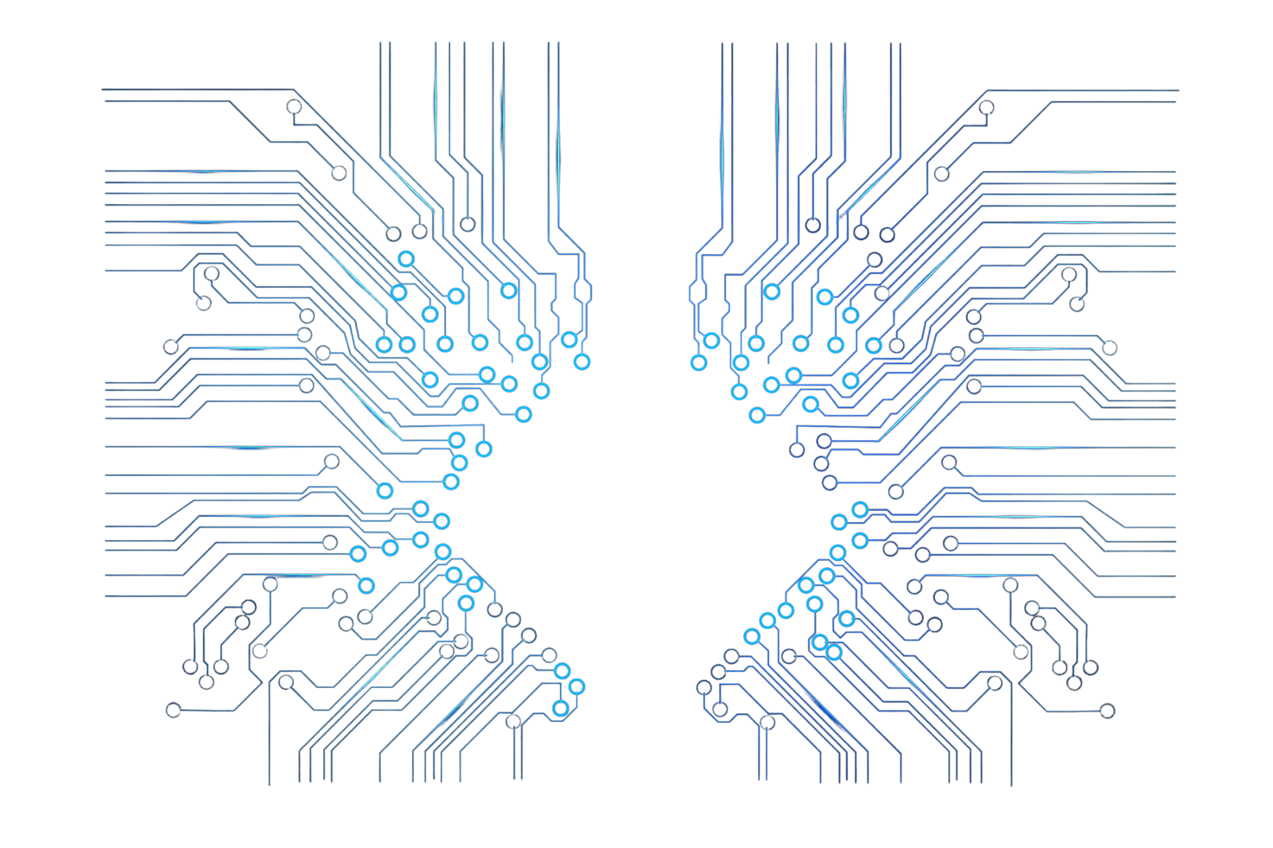
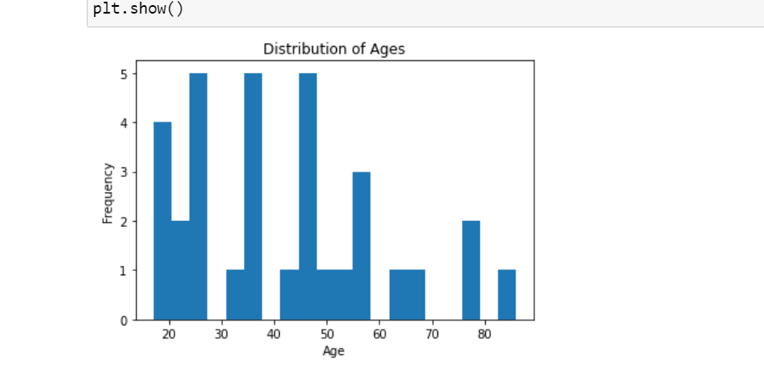
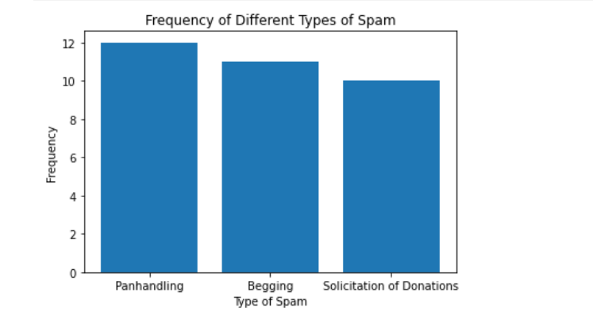
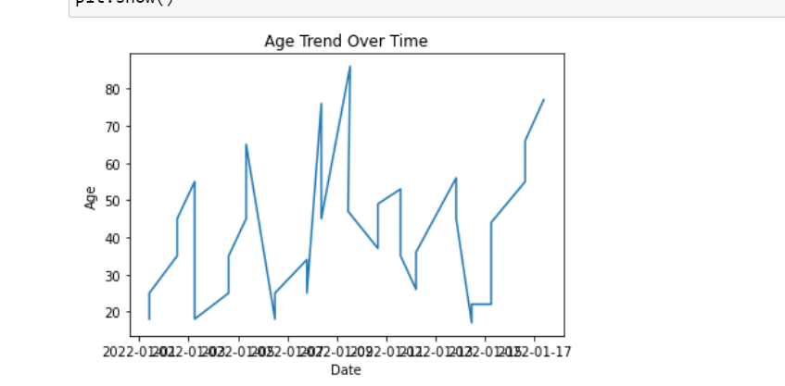
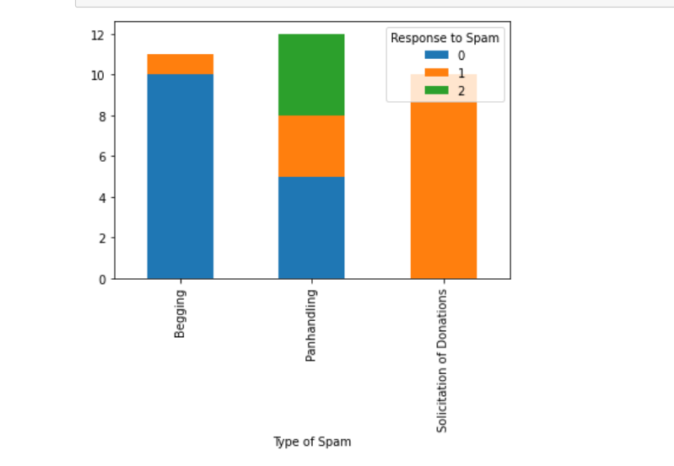
Results

Slide 12
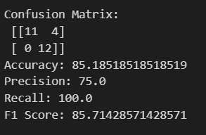
RANDOM FOREST:
RESULTS

Slide 13
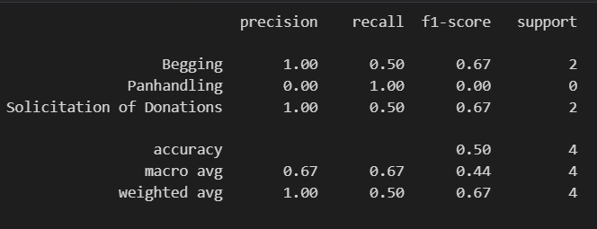
K-NEAREST NEIGHBOURS:
RESULTS

Slide 14
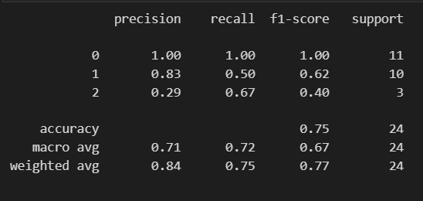
DECISION TREE:
RESULTS

Slide 15
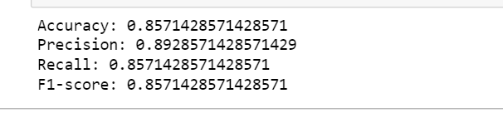
LOGOSTIC REGRESSION:
RESULTS

Slide 16
In conclusion, this study analyzed a dataset on spam emails to gain insights into factors that influence individuals’ responses and perceptions towards spam. The analysis revealed that age and gender have significant impacts on both response and perception towards spam. The study also implemented several machine learning algorithms to predict response and perception towards spam, achieving high accuracy and precision.
Overall, this project showcases the importance of data mining techniques in analyzing complex datasets and identifying meaningful patterns and insights. It also highlights the potential benefits of using algorithms to make accurate predictions and improve decision-making processes..
CONCLUSION

Slide 17
Despite the encouraging findings, this study has some drawbacks. First of all, the dataset used may not accurately reflect the greater population due to its small size. Second, because the information was provided voluntarily, it might contain prejudice or inaccuracies. Furthermore, the study's cross-sectional design makes it difficult to infer causal relationships. Finally, because the effectiveness of these methods depends so much on the particular dataset and context, it is possible that they will not generalize well to other datasets.
LIMITATIONS

Slide 18
Despite its shortcomings, this study offers important insights into the variables that may affect people's responses to spam messages. Future research could build on this work by examining the links between age, gender, and spam perception using larger and more varied datasets. Further research into the long-term causal links between these characteristics and spam replies could be done through longitudinal studies. Finally, the predictive models utilized in this study could be made more accurate by using more advanced machine learning techniques, such as deep learning.
FUTURE WORK

Slide 19
THANK YOU!

